Slide 1
Computer architecture and Organization I/O Organization
M. Khademul Islam, PhD Professor, Dept. of CSE, Rajshahi University, Bangladesh Email: khademul.cse@ru.ac.bd, tel: +88-01727-786600 web: www.ru.ac.bd/cse/~mki

Slide 2
I/O Organization
Peripheral devices
The input or output devices attached to the computer are also called peripherals.
Among the most common peripherals are keyboards, display units and printers
The peripherals that provide auxiliary storage for the system are magnetic disks and tapes.
The devices that are under the direct control of computer are said to be connected online.

Slide 3
I/O Organization
I/O Interface
Provides the method for transferring information between internal computing unit and external I/O devices.
Interface
I/O interface requires the following things:
Special hardware components between the CPU and peripherals
Supervise and synchronize all input and output transfers

Slide 4
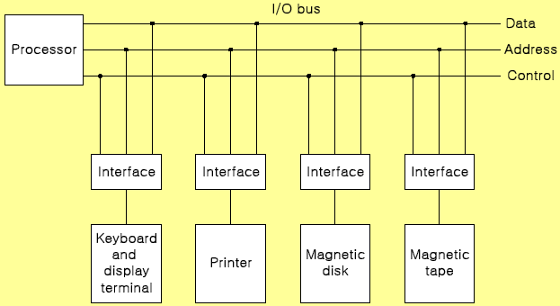
I/O Organization
I/O Bus and Interface Modules
The interface of I/O with CPU is performed by different I/O bus lines → Data lines, Address lines, Control lines:

Slide 5
I/O Organization
Interface Modules:
SCSI (Small Computer System Interface)
IDE (Integrated Device Electronics)
RS-232
USB (Universal Serial Bus)

Slide 6
I/O Organization
I/O versus Memory Bus
Computer buses are used to communicate with memory and I/O.
Three ways to make such communication:
Use two separate buses, one for memory and the other for I/O
Use one common bus for both memory and I/O but have separate control lines for each
Use one common bus for memory and I/O with common control lines

Slide 7
I/O Organization
Synchronous Data Transfer
All data transfers occur simultaneously during
the occurrence of a clock pulse
Registers in the interface share a common
clock with CPU registers
Asynchronous Data Transfer
Internal timing in each unit (CPU and Interface)
is independent
Each unit uses its own private clock for internal
registers

Slide 8
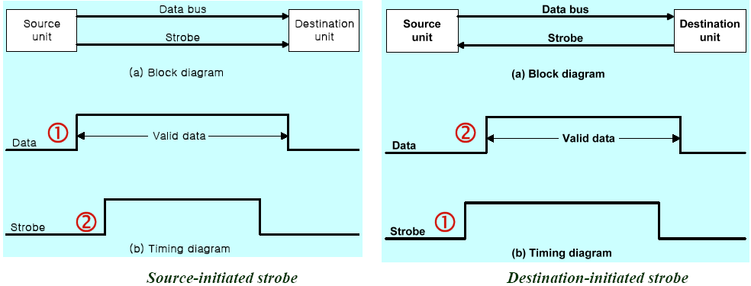
I/O Organization
Strobe : Control signal to indicate the time at which data is being transmitted
Source-initiated strobe
Destination-initiated strobe

Slide 9
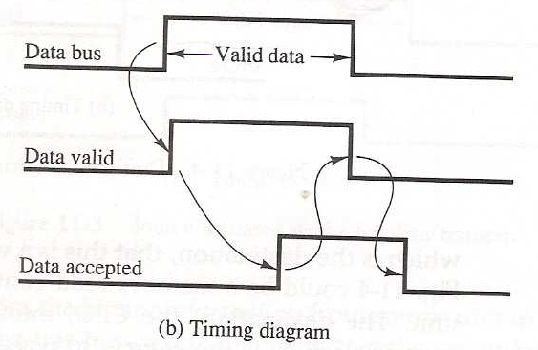
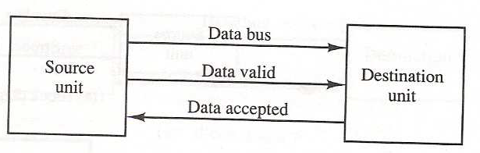

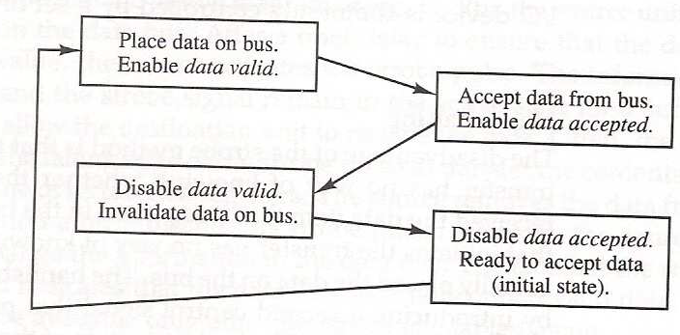

I/O Organization
Handshake: Agreement between two units
Source-initiated

Slide 10
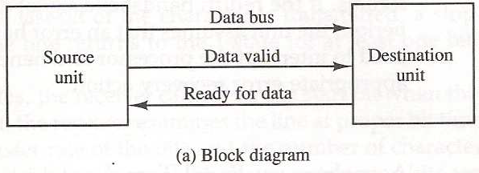
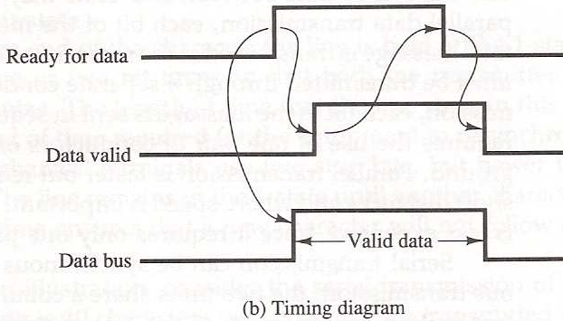
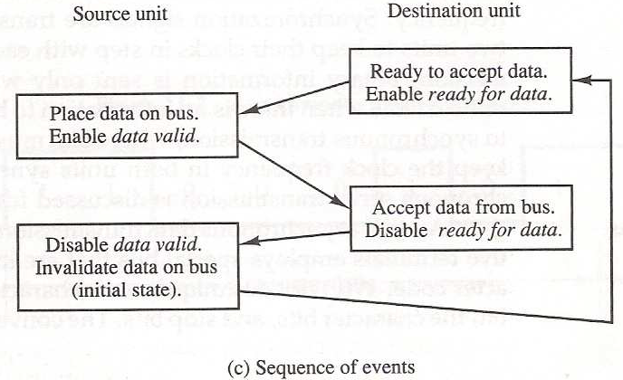
I/O Organization
Destination initiated handshake

Slide 11
I/O Organization
Asynchronous Data Transfer
Special bits are inserted at both ends of the character code
Each character consists of three parts :
start bit : always “0”, indicate the beginning of a character
character bits : data
stop bit : always “1”

Slide 12
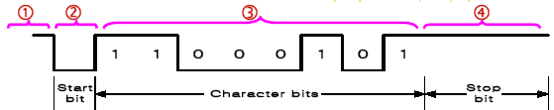
I/O Organization
Asynchronous transmission rules
(1) When a character is not being sent, the line is kept in the 1-state
(2) The initiation is detected from the start bit, which is always “0”
(3) The character always follow the start bit
(4) A stop bit is detected when the line returns to the 1-state for at least one bit time
UART (Universal Asynchronous Receiver): 8250

Slide 13
I/O Organization
Modes of Transfer
Data transfer to and from peripherals
1) Programmed I/O
2) Interrupt-initiated I/O
3) Direct Memory Access (DMA)
4) I/O Processor (IOP)

Slide 14
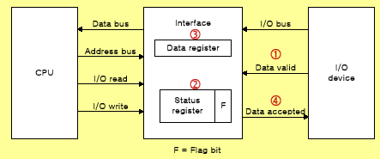
I/O Organization
Example of Programmed I/O

Slide 15
I/O Organization
Interrupt-initiated I/O
1) Non-vectored : fixed branch address
2) Vectored : interrupt source supplies the branch address
Priority Interrupt
Identify the source of the interrupts from simultaneous several sources
Determine which one is to be serviced first from simultaneous multiple requests

Slide 16
I/O Organization
Software Polling
Identify the highest-priority source by software means
Polls the interrupt sources in sequence
The highest-priority source is tested first

Slide 17
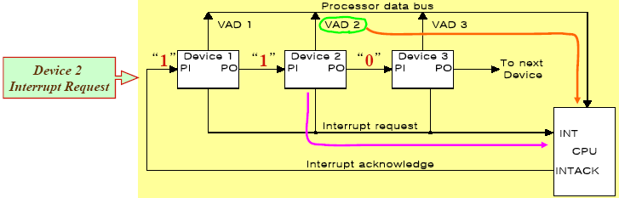
I/O Organization
Hardware priority interrupt
Daisy-Chaining, parallel priority
Daisy -chaining

Slide 18
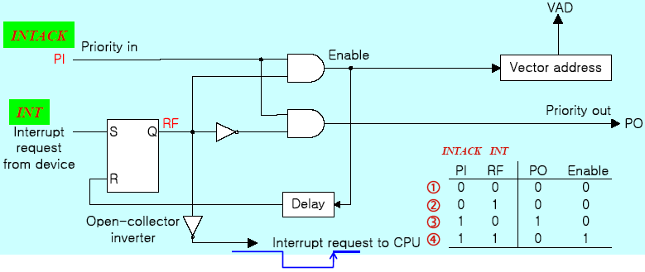
I/O Organization
(1) No interrupt request
(2) Invalid : interrupt request, but no ack (3) No interrupt request: Pass to other device
(4) Interrupt request
One step of DC

Slide 19
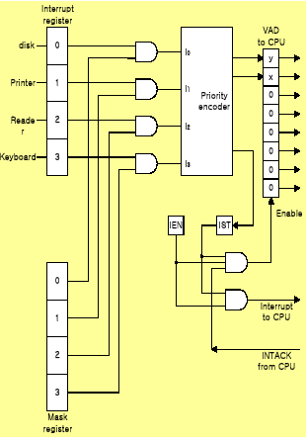
I/O Organization
Parallel Priority
Priority Encoder
Parallel Priority :
Interrupt Enable F/F (IEN): set or cleared by program
Interrupt Status F/F (IST): set or cleared by output

Slide 20
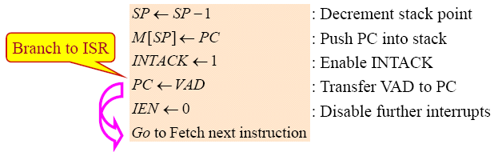
I/O Organization
Interrupt Cycle
At the end of each instruction cycle, CPU
checks IEN (Int. Enable) and IST (Int. Status)
if both IEN and IST equal to “1”
CPU goes to an Interrupt Cycle
Sequence of micro-operation during Interrupt cycle

Slide 21
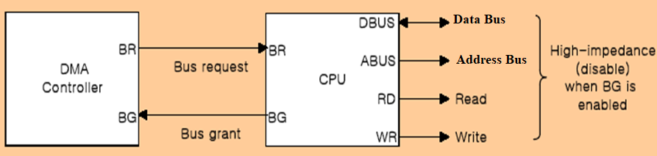
I/O Organization
Direct Memory Access (DMA)
DMA controller takes over the buses to manage the transfer directly between the I/O device and memory
Transfer Modes
Burst transfer : Block
Cycle stealing transfer : Word

Slide 22
I/O Organization
DMA Controller (Intel 8237 DMAC) Initialization Process
1) Set Address register: memory address for read/write
2) Set Word count register: the number of words to transfer
3) Set transfer mode :
read/write,
burst/cycle stealing,
I/O to I/O,
I/O to Memory,
Memory to Memory
Memory search
I/O search
4) DMA transfer start : next section
5) EOT (End of Transfer): Interrupt

Slide 23
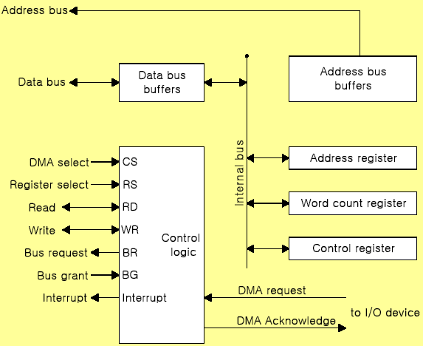
I/O Organization

Slide 24
I/O Organization
DMA Transfer (I/O to Memory)
1) I/O Device sends a DMA request
2) DMAC activates the BR line
3) CPU responds with BG line
4) DMAC sends a DMA acknowledge to the I/O device
5) I/O device puts a word in data bus (memory write)
6) DMAC write a data to the address specified by AR
7) Decrement Word count register
8) Word count register = 0 (EOT interrupt)
9) Word count register ≠ 0 (DMAC checks the DMA request from I/O device)

Slide 25
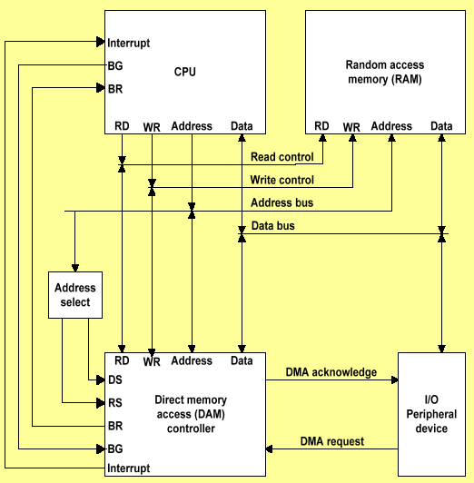
I/O Organization

Slide 26
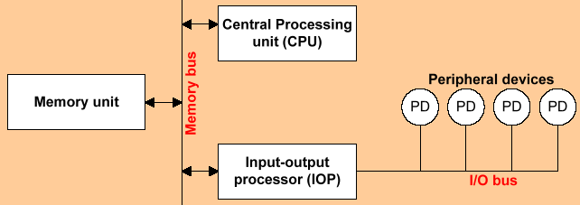
I/O Organization
Input-Output Processor (IOP)
Communicate directly with all I/O devices
Fetch and execute its own instruction
IOP instructions are designed for I/O transfer
DMAC must be set up entirely by the CPU
Designed to handle the details of I/O processing

Slide 27
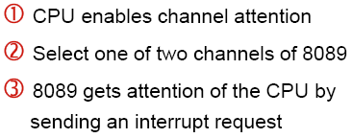
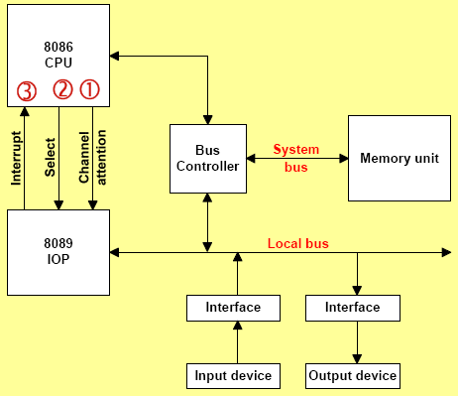
I/O Organization
Intel 8089 IOP

Slide 28
Bus Arbitration
Bus arbitration is required to decide which device gets control of the bus when multiple devices request it at the same time.
Why need?
To avoid conflicts
If two devices drive the bus at the same time, data will be corrupted.
Arbitration ensures that only one master uses the bus at a time.
To maintain system stability
If multiple masters try to access the bus simultaneously, the system may hang.
To ensure fair access
All devices should get a fair chance to use the bus.
The device that requests first or has higher priority gets access.

Slide 29
Bus Arbitration
Why need?
To control priority
Some devices (e.g., DMA controller) need higher priority.
To handle parallel requests
When many devices request the bus at the same time, the arbitration algorithm decides who will get access.

Slide 30
Bus Arbitration
Bus Arbitration Techniques
Daisy Chaining
Polling
Independent Request

Slide 31
Bus Arbitration
Daisy Chaining

Slide 32
Bus Arbitration
Daisy Chaining
Advantages
Simple design
The user can add more devices anywhere along the chain
Disadvantages
Priority is fixed
Lower-priority devices may face starvation
Delay increases in long chains
If one device fails then the entire system will stop working.

Slide 33
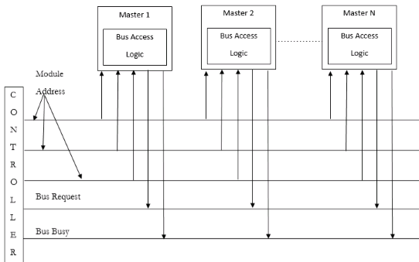
Bus Arbitration
Polling
In this, the controller is used to generate the address for the master(unique priority), the number of address lines required depends on the number of masters connected in the system.

Slide 34
Bus Arbitration
Polling
Advantages
This method does not favor any particular device and processor.
The method is also quite simple.
If one device fails then the entire system will not stop working.
To reduce the starvation problem.
Disadvantages
Adding bus masters is difficult as increases the number of address lines of the circuit.

Slide 35
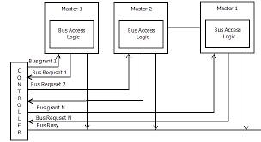
Bus Arbitration
Independent Request
The built-in priority decoder within the controller selects the highest priority request and asserts the corresponding bus grant signal.connecd in the system.

Slide 36
Bus Arbitration
Independent Request
Advantages
Priority control is easy
This method generates a fast response.
To reduce the starvation problem.
Disadvantages
Hardware cost is high as a large no. of control lines is required.

